Slide 1
Sphero Sprint Presentation
Chris A. James A. Robert B.

Slide 2
Challenges
Before Quarantine:
Learning to use Sphero Robot Software
During Quarantine:
Group Specific
Being able to physically demonstrate Robot performances to all team members
All team members having simultaneous access to internet as well as availability
Performance Specific
Having adequate space to test robot
Remembering how the test tracks were set up to the best of our ability

Slide 3
Team Roles
Chris A. - Coding Development and Robot Testing
James A. - Coding Development and Sprint Documentation
Robert B. - Sprint Documentation and Coding Review

Slide 4

What We Learned
Project Management
Gantt Chart and System Design Document
Testing and Engineering Code
How to work as a group through online limitations

Slide 5

What we would do differently
Keep to a tighter schedule for updating Documentation and Testing
Document classroom Sprint tracks better
Have better communication with the group

Slide 6

https://drive.google.com/file/d/1nOaWo9njj6VivWtVf-wVB7xMOiGPaYoG/view?usp=sharing

Slide 7
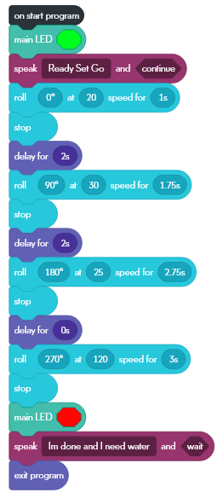
Block code for Sprint 3 - Agility

